Slide 1



UNIT 2
Look back 2
Part 3

Slide 2
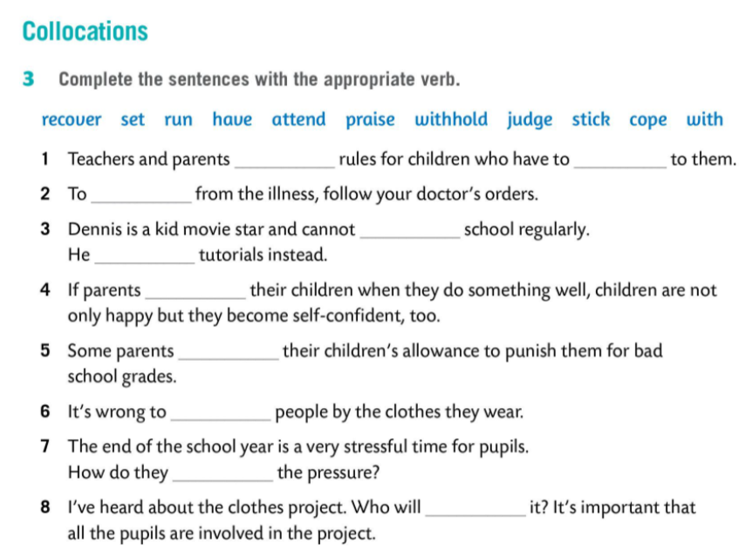
set
stick
recover
attend
has
praise
withold
judge
cope with
run

Slide 3
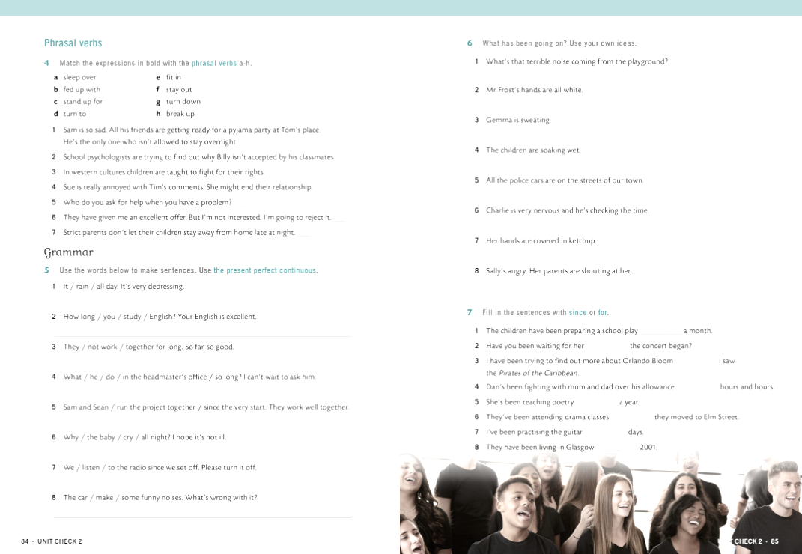
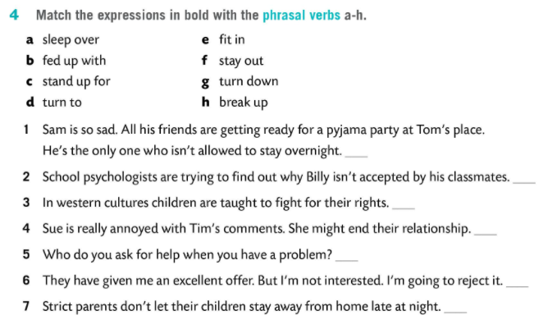
a
e
c
b, h
d
g
f

Slide 4
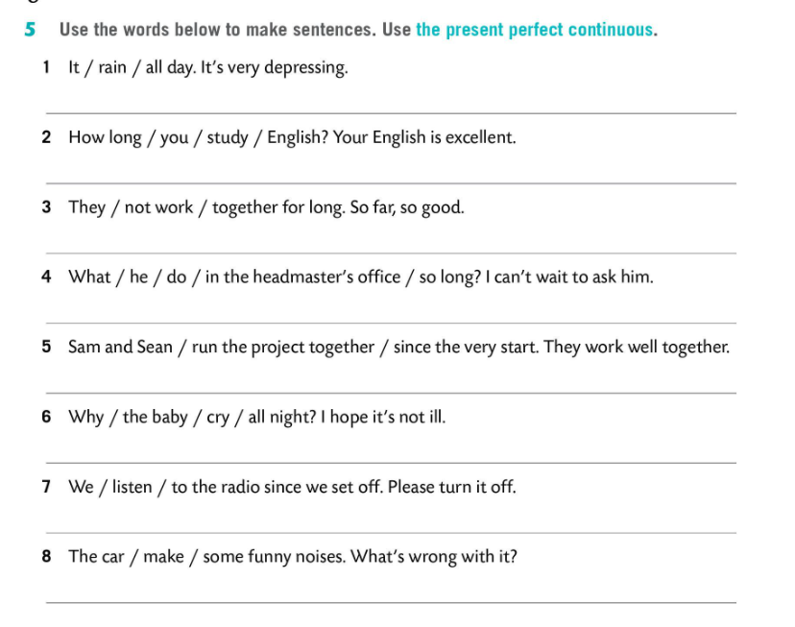
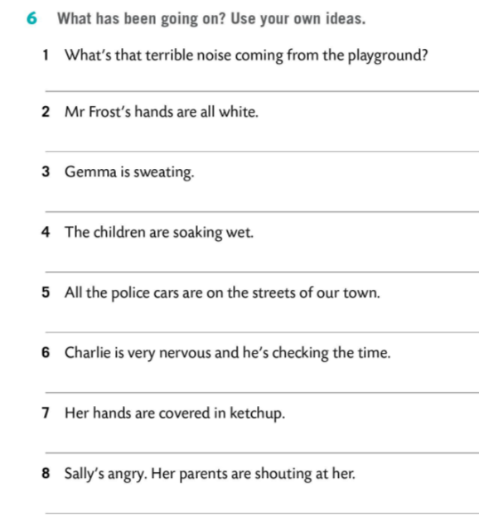
It has been raining all day.
How long have you been studying English?
They haven’t been working together for long.
What has he been doing in the headmaster’s office so long?
Sam and Sean have been running the project since the very start.
Why has the baby been crying all night?
We have been listening to the radio since we set off.
The car has been making some funny noises.

Slide 5
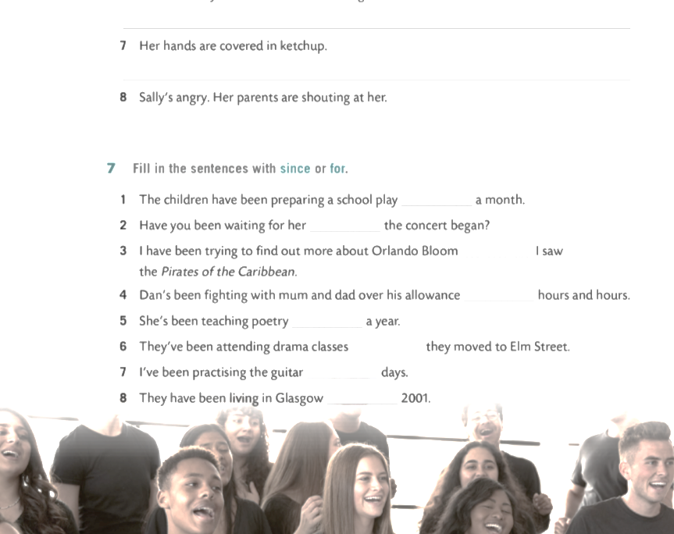
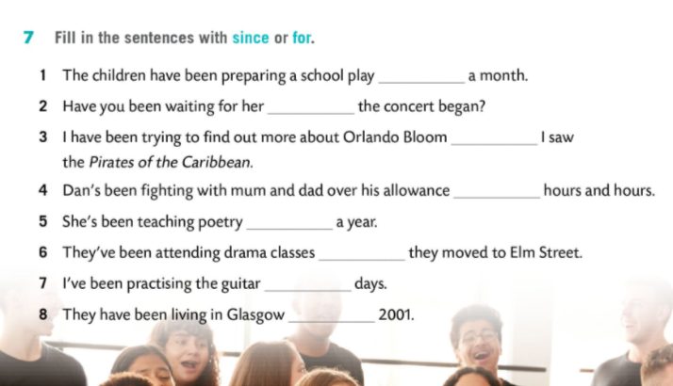
for
since
since
for
for
since
for
since

Slide 6
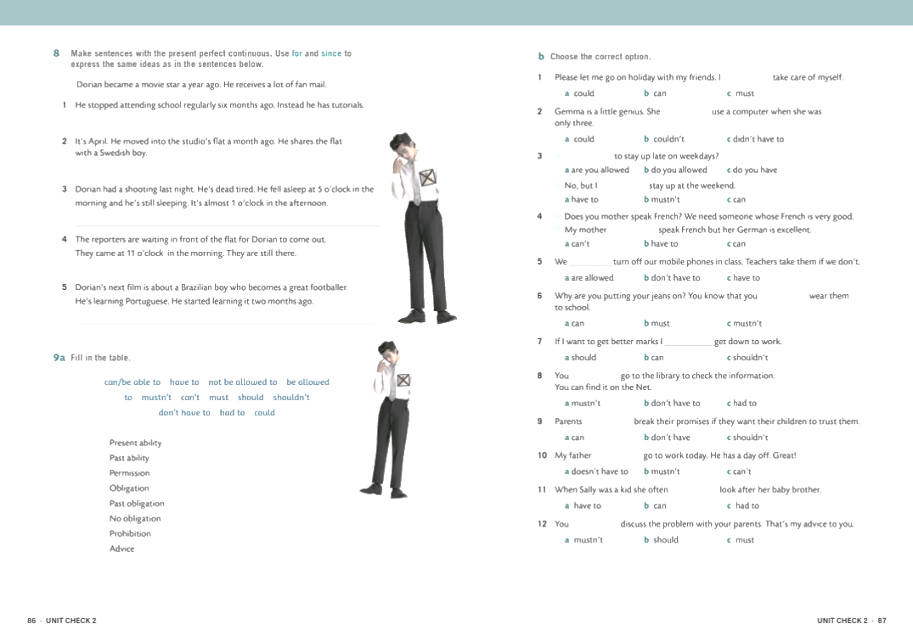
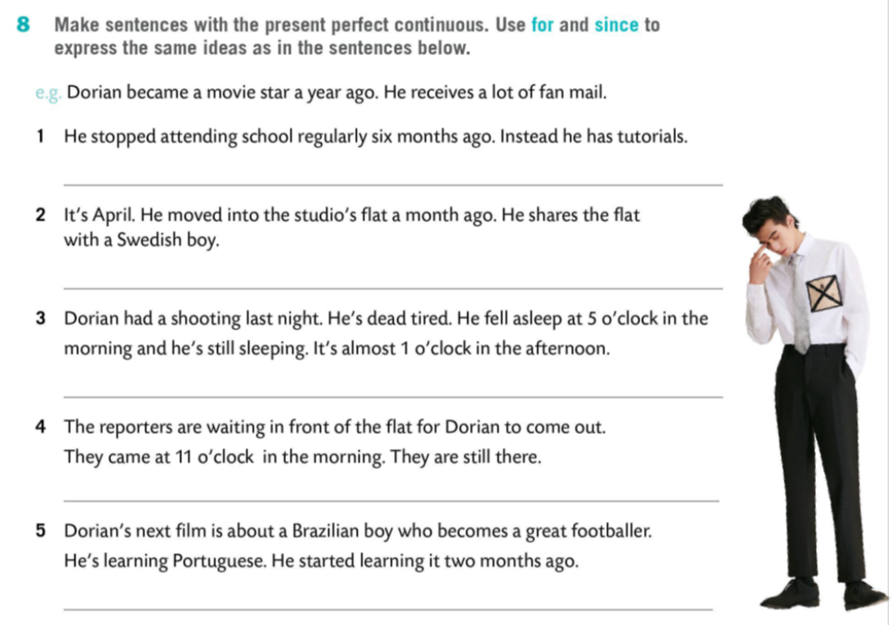
He has been having tutorials for six months.
He has been sharing the studio flat with a Swedish boy for a month.
Dorian has been sleeping since 5 in the morning (for almost 8 hours).
The reporters have been waiting for him in front of his flat since 11 o’clock.
Dorian has been learning Portuguese for two months.

Slide 7
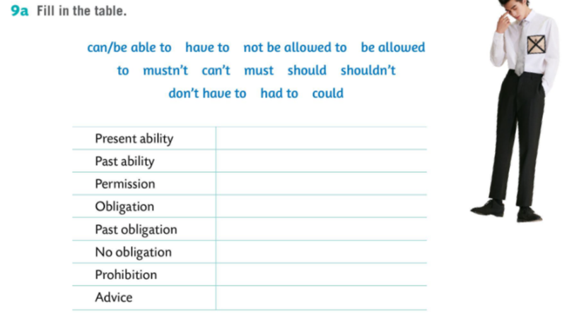
can, can’t
could
can, allowed, not allowed
have to, must
had to
don’t have to
mustn’t
should, shouldn’t

Slide 8
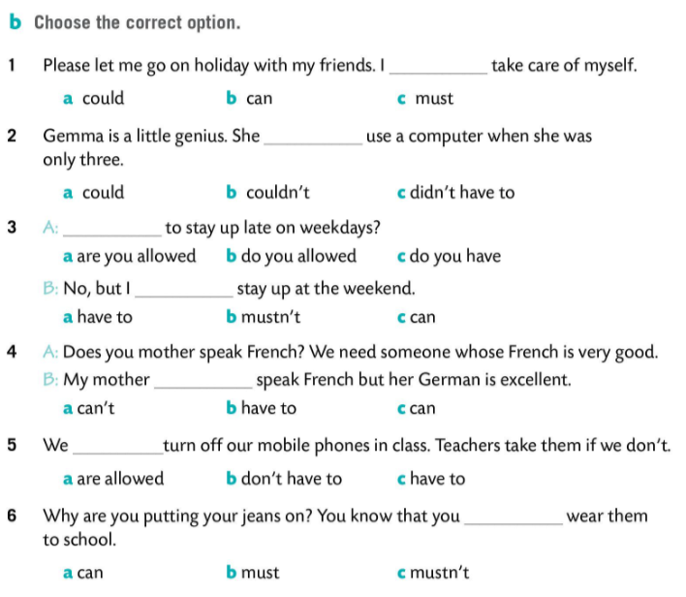
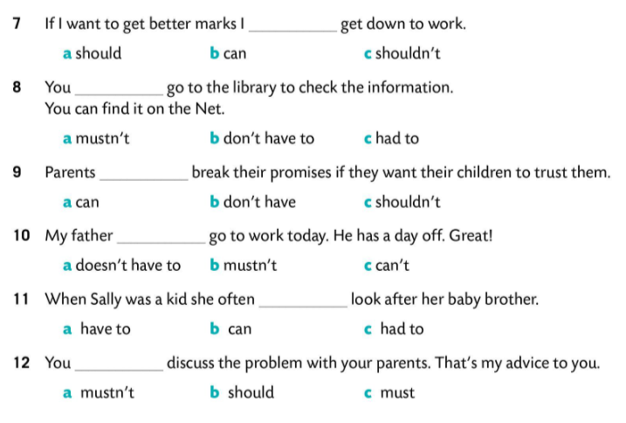

Slide 9
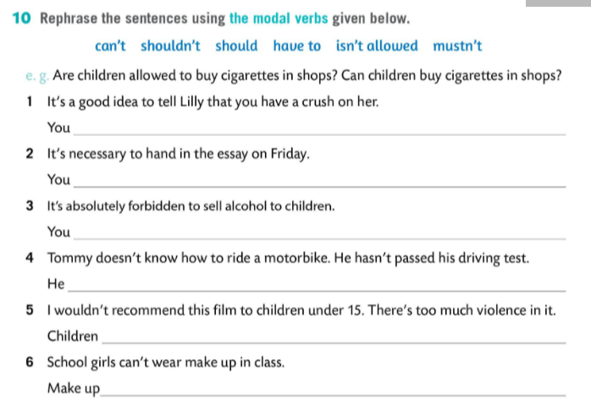

should tell Lilly that …
have to hand in …
mustn’t sell …
can’t ride a motorbike.
shouldn’t watch this film.
isn’t allowed in class.

